Slide 1



Design Azure Web and Mobile Apps
Web Apps
API Apps
Mobile Apps
Push Notification
Eric Franz | Solution Lead

Slide 2
Exam 70-534 Architecting Microsoft Azure Solutions
#1 Design Azure Resource Manager (ARM) networking (5–10%)
Design Azure virtual networks - Extend on-premises
Describe Azure VPN and Express Route architecture and design
#2 Secure resources (20–25%)
Secure resources by using managed identities
Secure resources by using managed identities
Secure resources by using identity providers
Identify an appropriate data security solution
Design a role-based access control (RBAC) strategy
Manage security risks by using an appropriate security solution
#3 Design an application storage and data access strategy (5–10%)
Design data storage
Select the appropriate storage option
#4 Design advanced applications (20–25%)
Create compute-intensive applications
Create long-running applications
Integrate Azure services in a solution
Implement messaging applications
Implement applications for background processing
Design connectivity for hybrid applications
#5 Design Azure Web and Mobile Apps (5–10%)
Design Web Applications
Design Mobile Applications
#6 Design a management, monitoring, and business continuity strategy (20–25%)
Design a monitoring strategy
Describe Azure business continuity/disaster recovery (BC/DR) capabilities
Design a disaster recovery strategy
Design Azure Automation and PowerShell workflows
Describe the use cases for Azure Automation configuration
#7 Architect an Azure Compute infrastructure (10–15%)
Design ARM Virtual Machines (VMs)
Design ARM template deployment
Design for availability
+ Bonus: Containers
https://www.microsoft.com/learning/en-us/exam-70-534.aspx

Slide 3
#5 Design Azure Web and Mobile Apps (5–10%)
1. Design Web Applications
Design Azure App Service Web Apps,
design custom web API,
offload long-running applications using WebJobs,
secure Web API using Azure AD,
design Web Apps for scalability and performance,
deploy Azure Web Apps to multiple regions for high availability,
deploy Web Apps,
create App Service plans,
design Web Apps for business continuity,
configure data replication patterns,
update Azure Web Apps with minimal downtime, back up and restore data, design for disaster recovery
Design Mobile Applications
Design Azure Mobile Services;
consume Mobile Apps from cross-platform clients;
integrate offline sync capabilities into an application;
extend Mobile Apps using custom code;
implement Mobile Apps using Microsoft .NET or Node.js;
secure Mobile Apps using Azure AD;
implement push notification services in Mobile Apps;
send push notifications to all subscribers, specific subscribers, or a segment of subscribers

Slide 4
Web Apps and Mobile Apps in 70-534
App Service
Web Apps
Mobile Apps
Web API Apps
Azure Functions
SQL Database
Azure AD
Notification Hub
Virtual Network (VPN)
Hybrid Connections
CDN
Traffic Manager
Security Options
Azure AD
External Identity Providers
Deployment
Scalability
High Availability
Disaster Recovery

Slide 5
App Service Web Apps

Slide 6
Azure App Service

Slide 7


Azure App Service Build and scale great cloud apps
Web Apps
Mobile Apps
Logic Apps
API Apps

Slide 8
App Service - one integrated offering
Web Apps
Mobile Apps
Web apps that scale with your business
Build Mobile apps for any device
LOGIC Apps
API Apps
Automate business process across SaaS and on-premises
Easily build and consume APIs in the cloud

Slide 9
Develop apps with…
.NET | Node.js | PHP | Python | Java

Slide 10
Benefits of App Services
Automatic OS patching
Enterprise-grade security
High availability
Automated scale out/in
Built-in load balancing
Supports many languages and platforms
.NET, Node.js, Python, Ruby and many more
Easy continuous deployment
Continuous delivery from third-party source control providers
Built-in Git repo

Slide 11



Web Apps
Logic Apps
Mobile Apps
Administration App
Customer site
Order Completed
Customer App
http
SQL
API Apps

Slide 12
Web Apps

Slide 13
Full capability set available including:
.NET, Node.js, Java, PHP, and Python
WebJobs for long running tasks
Integrated VS publish, remote debug…
CI with GitHub, BitBucket, VSO
Auto-load balance, Autoscale, Geo DR
Virtual networking and hybrid connections
Site slots for staged deployments
Web Apps
Web apps run as-is
no changes required

Slide 14
App Service Web App Architecture
Deployment
Server(s)
File Server
Publish Endpoint
Blob Storage
Application Database
Frontend (IIS ARR)
Microsoft Azure
Load Balancer
Metering

Slide 15
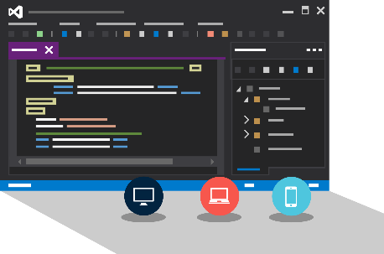
Visual Studio + App Service Web Apps
Create Azure Resources during File / New
Create Web App during deploy
Manage with Server Explorer

Slide 16
WebJobs

Slide 17






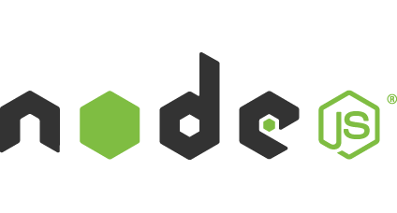

Light-weight CPU Intensive Tasks
run.cmd, run.bat
run.exe
run.ps1
run.sh
run.php
run.py
run.js
Job Type:
On-Demand, Scheduled, Continuous
Scale:
Singleton, Multi-instance
WebJobs SDK Feature:
BlobTrigger, TableTrigger, QueueTrigger, ServicebusTrigger
Deployment:
Portal, Visual Studio, CLI, Git

Slide 18
API Apps

Slide 19
Easily use cloud or custom APIs:
Dozens of built-in APIs for popular SaaS
An ecosystem of APIs for any need
Create and publish custom, reusable APIs
Visual Studio tooling with one click publish and remote debugging
Automatic client SDK generation for many languages
Api Apps
Create, consume and
host APIs more easily

Slide 20
Benefits of API Apps
Bring your API as-is
.NET Web API
Node.js + Express
Java
PHP
Many other technologies
Connect easily to SaaS platforms

Slide 21
API Apps addresses key pains around building and consuming APIs
Build your API
Consume APIs
Web Apps++: Bring you API as is in your language of choice
API discovery
SDK generation
SSO, handled by server
Authentication, built-in to mobile and web SDKs
Expose enterprise APIs
Microservice style
Metadata contract
SSO
Simple access control
Gallery – public & organization

Slide 22
Consuming API Apps
API Apps expose HTTP services
Metadata is exposed using Swagger 2.0 metadata
JSON file
Widely supported
Client applications

Slide 23
Enterprise connectivity
Dynamics
SQL
SAP
Oracle

Slide 24




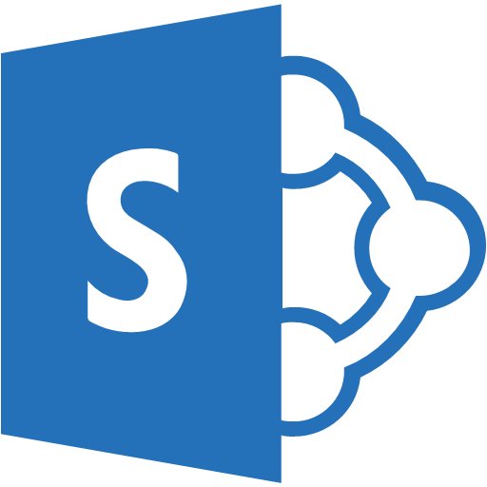

Simplifying Integration
Managed Middle Tier
API App[s]
On Premise Applications
Databases in Azure VMs
SharePoint Online
Cloud-Hosted Web Apps
SSO, Auth, Scale, etc.

Slide 25
Logic Apps

Slide 26
New Logic Apps for easy automation
No code designer for rapid creation
Dozens of pre-built templates to get started
Out of box support for popular SaaS and on-premises apps
Use with custom API apps of your own
Biztalk APIs for expert integration scenarios
LOGIC Apps
Automate SaaS and
on-premises systems

Slide 27
SaaS integration

Slide 28
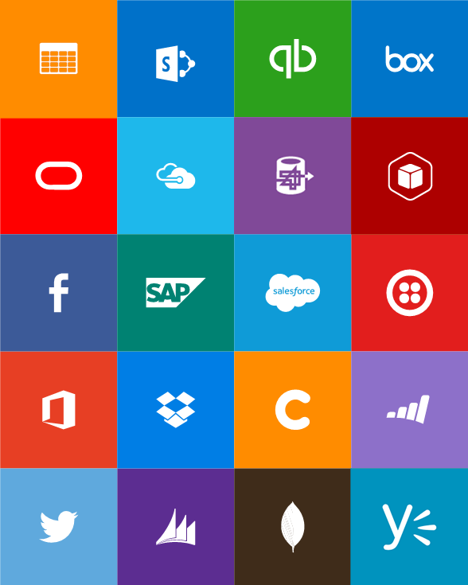
Built-in API Connectors
Connectors
Box
Chatter
Delay
Dropbox
Azure HD Insight
Marketo
Azure Media Services
OneDrive
SharePoint
SQL Server
Office 365
Oracle
QuickBooks
SalesForce
Sugar CRM
SAP
Azure Service Bus
Azure Storage
Timer / Recurrence
Twilio
Twitter
IBM DB2
Informix
Websphere MQ
Azure Web Jobs
Yammer
Dynamics CRM
Dynamics AX
Hybrid Connectivity
Protocols
BizTalk Services
HTTP, HTTPS
File
Flat File
FTP, SFTP
POP3/IMAP
SMTP
SOAP + WCF
Batching / Debatching
Validate
Extract (XPath)
Transform (+Mapper)
Convert (XML-JSON)
Convert (XML-FF)
X12
EDIFACT
AS2
TPMOM
Rules Engine

Slide 29
Target audience is anyone who can use Azure
… but not necessarily business users or consumers

Slide 30
Mobile Apps

Slide 31
New capabilities for Mobile apps:
Webjobs for long running tasks
CI with GitHub, BitBucket, VSO
Auto-load balance, Autoscale, Geo DR
Virtual networking and hybrid connections
Site slots for staged deployments
Mobile Apps
Mobile services plus
a whole lot more

Slide 32







Azure Mobile Services
Storage
Authentication
Logic
Push
Scheduler
Notes:
Speaking Notes
Summarize earlier slide
Azure Mobile Services is a Backend-as-a-Service
Instead of you having to design, build, test, deploy, manage, and upgrade your whole backend, we do it for you
Features of Mobile Services
Storage – SQL DB
Authentication – built in support for social providers w/ ability to custom auth
Backend logic – data validation, logical flows, etc
Push Notifications – across all major mobile platforms
Scheduler – backend job processing

Slide 33
Structured Storage
Powered by SQL Database
Supports rich querying capabilities
Dynamic Schematization
Data management in:
Azure Portal
SQL Portal (Silverlight)
SQL Management Studio
REST API
Azure CLI Tools
SQL CLI
Microsoft Azure
Notes:
Speaking points
Mobile Service easily connects to SQL Database
SQL offers rich querying and indexing capabilities
Dynamic Schematization means you don’t have to be a DBA and manage schema
Data can be managed in:
Azure Portal (read and delete data)
SQL Portal (Silverlight)
SQL Management Studio (windows)
REST API (used by SDKs)
Azure CLI tools
SQL CLI (Node module)

Slide 34
Server Side Table Scripts
Node.js scripts
.NET Web API
backend in
Visual Studio
Passes through to SQL by default
MongoDB, Table Storage, SQL out of the box
Intercept CRUD requests to tables
Fully customizable
Notes:
Speaking points
Node backend generates Node scripts for each table action
Scripts intercept CRUD requests
Pass to SQL by default
Custom logic added here
Edit in portal (NODE)
.NET Backend creates Visual Studio project

Slide 35
Custom API
Non-table based endpoints
Accessible from
GET
POST
PUT
PATCH
DELETE
For node.js logic in scripts like table endpoints
For .NET delivered through a WebAPI
Expose any functionality you want
Microsoft Azure
Notes:
Speaking points
All scripts so far tied to a table action
Custom APIs are non-table based endpoints
Script functionality for normal HTTP methods

Slide 36
Continous Delivery with App Service

Slide 37
Continuous integration

Slide 38

Continuous Deployment for Web Apps
Web App Production Slot
Agility through Continuous Deployment
Auto-Swap
Hooks
Git pull
Commits
Changes
Web App Staging Slot
Source Control / Code Repo
Developer

Slide 39
AutoScale

Slide 40

AutoScale
Web App

Slide 41
AutoScale
Web App
Notes:
CPU / Memory / Disk Queue/ Http Queue / Data In / Data Out
Similar measures against a Storage queue, Service Bus Queue or an Application Insights metric.

Slide 42
AutoScale
Web App
Notes:
CPU / Memory / Disk Queue/ Http Queue / Data In / Data Out
Similar measures against a Storage queue, Service Bus Queue or an Application Insights metric.

Slide 43
App Service Environment

Slide 44
App Service Environment (ASE)
New Premium Tier Feature
Dedicated compute resources and network resources
Increased Scaling Options
Directly created in a Virtual Network
Support all Web App features and capabilities
Support Web, Mobile and API Apps
Global Scale

Slide 45
Conceptual Model
App Service Plan
App Service Plan
App Service App
App Service App
App Service App
App Service App
App Service App
App Service App
SKU: Premium (# of sites, storage, slots…)
Compute Resource: P4 ( 8 cores, 14 GB memory)
Scale: 8
SKU: # of sites, storage, slots…
Compute Resource: cores, memory
Scale: number of instances
Note: For App Service Environment the SKU will always be Premium
Notes:
Speaker notes:
Explain how ASE differ from multi-tenant App Service using App Service Plan.

Slide 46
Application Insights

Slide 47
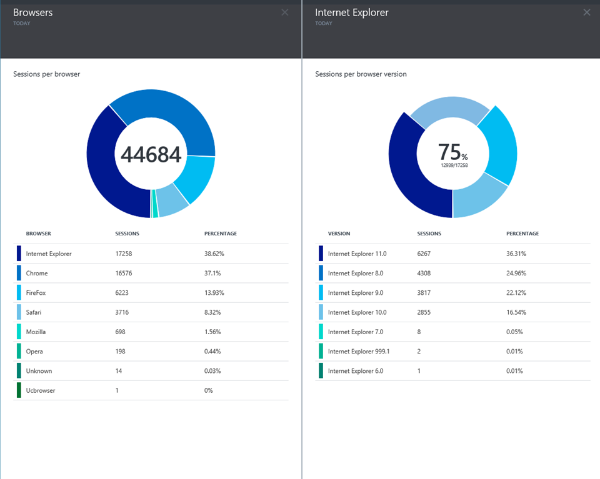
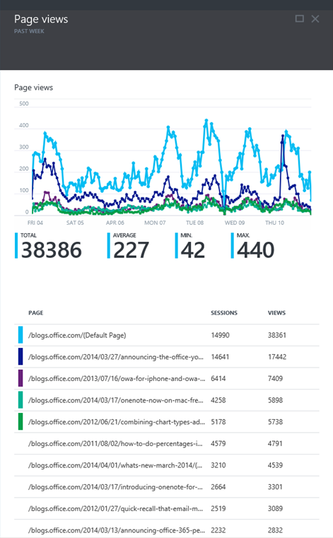
Application Insights
Application Insights

Slide 48
There are many Azure products and features you need to be familiar with for the exam. In preparing for the exam, you should strive for at least an introductory level of understanding of Azure products that are not specifically called out in the exam skills. This will help you rule out choices when you see them on the exam.

Slide 49
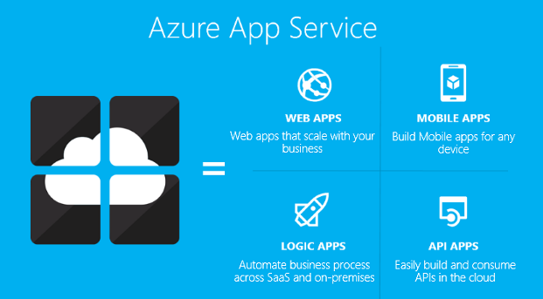
App Service
Authentication
Backup/Restore
Deployment
Networking
Scalability
WebJobs

Slide 50
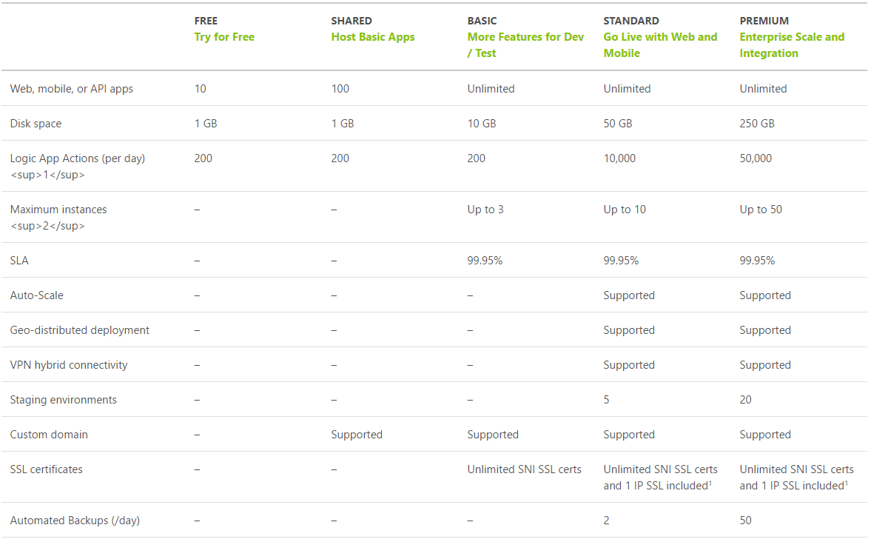
App Service Plan Tiers
https://azure.microsoft.com/en-us/pricing/details/app-service/plans/
Notes:
For example you may get a question like “I need custom domains”
YOU NEED AS HOMEWORK TO REVIEW THIS TIERED MATRIX

Slide 51
App Service Plan
Represents the collection of physical resources used to host your apps
Region (West US, East US, etc.)
Scale count (one, two, three instances, etc.)
Instance size (Small, Medium, Large)
SKU (Free, Shared, Basic, Standard, Premium)
Web Apps, Mobile Apps, API Apps, Functions run in an App Service Plan
Notes:
Create App Service Plans
Azure App Service plans in-depth overview
https://docs.microsoft.com/en-us/azure/app-service/azure-web-sites-web-hosting-plans-in-depth-overview?toc=%2fazure%2fapp-service-web%2ftoc.json

Slide 52
You have an web app that is to be deployed in two data centers (east us and west us) and will use traffic manager, what is the least expensive service plan you can use?
Free
Shared
Basic
Standard
Premium
Notes:
#2 SHARED
You need at least Shared Thru Premium to configure custom DNS for an azure website
Traffic Manager is actually listed on the plans page, it just didn’t fit on screenshot the point is you got to review that matrix

Slide 53

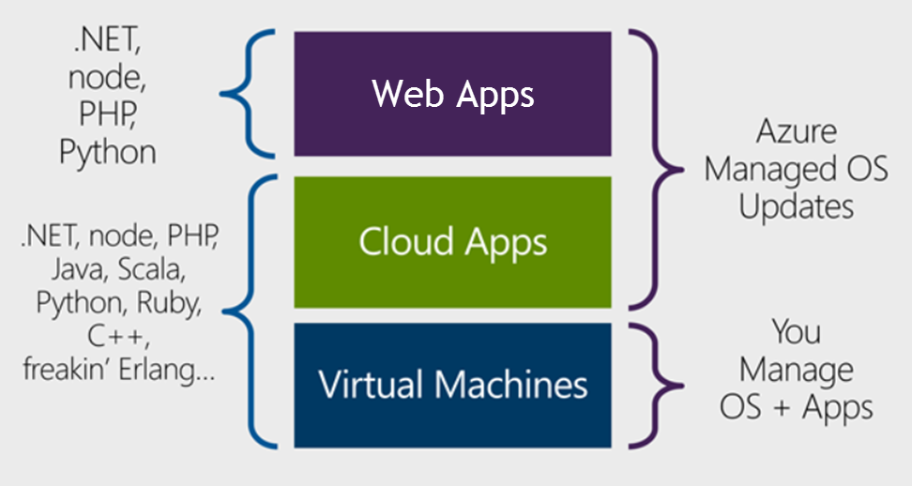
Design Azure App Service Web Apps
Cloud Services
Notes:
Design Azure App Service Web Apps
Web Apps overview
https://docs.microsoft.com/en-us/azure/app-service-web/app-service-web-overview
https://docs.microsoft.com/en-us/azure/app-service-web/choose-web-site-cloud-service-vm#scenarios

Slide 54
Design Azure App Service Web Apps
Platform as a Service (PaaS)
Azure Resource Manager (ARM) Technology
Easy to use with existing development skills:
VSTS/Git/GitHub/etc. for deployment Visual Studio integration
Other Azure options for deploying web applications:
Virtual Machines (IaaS)
Service Fabric (Microservice architectures)
Cloud Services (Web Roles and Worker Roles) – Older ASM technology
Notes:
ASM = Azure Service Manager

Slide 55
When creating a website in Azure, which Azure services can you use?
Cloud Services
Virtual Machines
Web Apps
Notes:
3

Slide 56
Quite a few Azure services provide the same capability. You need to understand the features and common usages in order to pick the best choices on the exam.
Example:
Virtual machines and web apps can be used for websites however you cannot remote desktop to a web app machine.

Slide 57

Design Custom Web API
Web API is a one or more RESTful services (with one or more operations)
Endpoints expose services to external, partner or internal developers
Can implement in several technologies:
ASP.Net Web API
Node.js
App Service options:
Web App (if you need a web site too)
Mobile App
API App
Notes:
Design Custom Web API
Create a REST service using ASP.NET Web API and SQL Database in Azure App Service
https://docs.microsoft.com/en-us/azure/app-service-web/web-sites-dotnet-rest-service-aspnet-api-sql-database
https://azure.microsoft.com/en-us/services/api-management/

Slide 58
WebJobs
Flexible way to run background jobs
Runs on same resources as Web/Mobile/API app
Can be .cmd, .bat, .exe, .ps1, .sh, .php, .py, .js, .jar
Execution options:
Continuous (make sure App Settings has Always On enabled)
On Demand
Scheduled
Can scale with Web App or only run on single instance
WebJob SDK provides binding and triggering system
Notes:
Offload Long-Running Applications Using WebJobs
Deploy WebJobs using Visual Studio
https://docs.microsoft.com/en-us/azure/app-service-web/websites-dotnet-deploy-webjobs
Run Background tasks with WebJobs
https://docs.microsoft.com/en-us/azure/app-service-web/web-sites-create-web-jobs

Slide 59
What is the best option to add background processing to your web app?
Virtual Machines
Cloud Services
Worker Roles
Web Jobs
Network Security Groups
Notes:
#4

Slide 60
Secure App Service – Azure AD
Azure AD B2B collaboration lets you enable access to your corporate applications from partner-managed identities. You can create cross-company relationships by inviting and authorizing users from partner companies to access your resources.
Azure Active Directory B2C is a highly available, global, identity management service for consumer-facing applications that scales to hundreds of millions of identities.

Slide 61
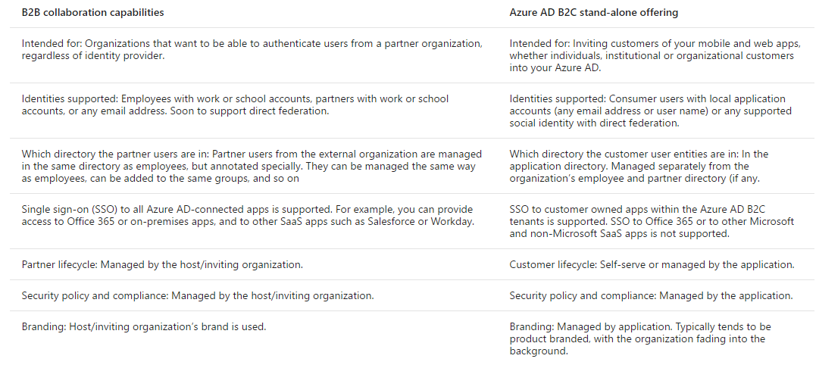
Azure AD B2B vs B2C
https://docs.microsoft.com/en-us/azure/active-directory/active-directory-b2b-compare-b2c

Slide 62
Secure App Service Options
On Premises AD
1. Connect and Sync with Azure AD
2. Authenticate through Azure AD
Azure AD B2B or B2C
Facebook
Google
Twitter
Microsoft Account
Notes:
Secure Web API using Azure AD
How to configure your App Service application to use Azure Active Directory login
https://docs.microsoft.com/en-us/azure/app-service-mobile/app-service-mobile-how-to-configure-active-directory-authentication
Secure an app in Azure App Service
https://docs.microsoft.com/en-us/azure/app-service-web/web-sites-security
Authentication and authorization in Azure App Service
https://docs.microsoft.com/en-us/azure/app-service/app-service-authentication-overview?toc=%2fazure%2fapp-service-mobile%2ftoc.json
Developing Web and Cross Platform Mobile Apps with Azure Active Directory
https://channel9.msdn.com/Events/Ignite/2015/BRK4850
Compare B2B collaboration and B2C in Azure Active Directory
https://docs.microsoft.com/en-us/azure/active-directory/active-directory-b2b-compare-b2c

Slide 63
You have a web app that needs to authenticate users against Active Directory but need to authenticate external users using social identity providers like Facebook and Twitter. Which services will you use?
Azure AD
Azure AD Domain Services
Twitter Bootstrap
App Service Authentication
Notes:
4
(App Service Authentication) is a tab on the config pages of the web app which clearly shows organizational accounts and social accounts which is why it is good not just to study the point, but to click around in a portal.

Slide 64
Authentication and authorization is very important in real life and for this exam. App Service, Web Apps, Mobile Apps and API Apps can use the same App Service Authentication. You should plan time to explore and experiment with how to utilize the feature.

Slide 65
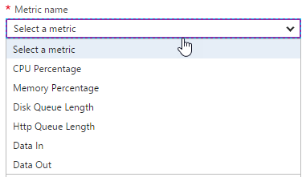
Design for Scalability and Performance
Scale Up – Change pricing tiers: Free, Shared, Basic, Standard, Premium
Scale Out – Change instance count: manually, auto
Scaling condition rules: Scheduled or Metric
Can have multiple condition rules
Can notify via email or webhook when autoscale events occur
Notes:
Design Web Apps for Scalability and Performance
Scale up an app in Azure
https://docs.microsoft.com/en-us/azure/app-service-web/web-sites-scale
Scale instance count manually or automatically
https://docs.microsoft.com/en-us/azure/monitoring-and-diagnostics/insights-how-to-scale?toc=%2fazure%2fapp-service-web%2ftoc.json

Slide 66
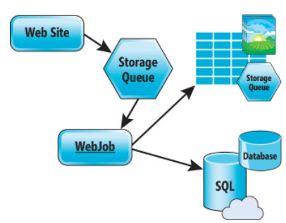
Design for Scalability and Performance
Design for Scale Out
Move towards stateless or at least distributed session/cache
Redis Cache for any Session/Cache needed
Move towards asynchronous UI
Queues for passing work off
Notes:
Azure Web Sites : Scaling Your Web Application with Azure Web Sites
https://msdn.microsoft.com/en-us/magazine/dn786914.aspx
Deploy Azure Web Apps to Multiple Regions for High Availability
Controlling Azure web app traffic with Azure Traffic Manager
https://docs.microsoft.com/en-us/azure/app-service-web/web-sites-traffic-manager
Add a Content Delivery Network (CDN) to an Azure App Service
https://docs.microsoft.com/en-us/azure/app-service-web/app-service-web-tutorial-content-delivery-network

Slide 67
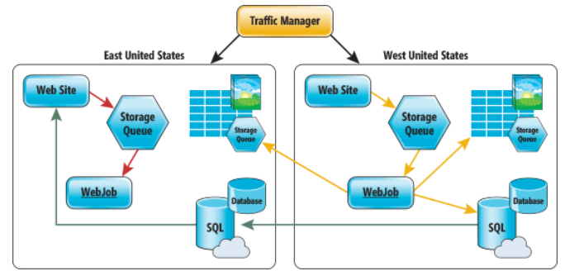
Deploy Azure Web Apps to Multiple Regions
Traffic Manager for routing traffic between regions
Performance – for directing user to closest region Failover – for secondary site Round Robin – for balancing traffic
CDN
Places static content close to user (images, media, etc)
Notes:
Deploy Azure Web Apps to Multiple Regions for High Availability
Controlling Azure web app traffic with Azure Traffic Manager
https://docs.microsoft.com/en-us/azure/app-service-web/web-sites-traffic-manager
Add a Content Delivery Network (CDN) to an Azure App Service
https://docs.microsoft.com/en-us/azure/app-service-web/app-service-web-tutorial-content-delivery-network
Best Practices: Windows Azure Websites (WAWS)
https://azure.microsoft.com/en-us/blog/best-practices-windows-azure-websites-waws/

Slide 68
You are going to deploy your web application on the east coast and west coast. You also want to make sure your users are sent to the closest location. What three things do you need to do?
Create a Traffic Manager profile
Set the Routing method to priority
Set the Routing method to performance
Create a new Resource Group
Add configure the endpoints in Traffic Manager
Notes:
1,3,5

Slide 69
Deploy
Web Deploy
Kudu (Git/Mercurial/OneDrive/Dropbox)
VSTS/Github/Bitbucket
Browser drag and drop (Chrome and Firefox)
FTP/FTPS
Filezilla, Windows Explorer
App Service infrastructure can be setup using PowerShell, Azure CLI or RM templates
Notes:
Deploy Web Apps
Deploy your app to Azure App Service
https://docs.microsoft.com/en-us/azure/app-service-web/web-sites-deploy

Slide 70
Update Web Apps with Minimal Downtime
Deployment Slots are live apps with their own hostnames
Only available for Standard or Premium App Service plans
Number of slots available depend on App Service Plan
App content and configurations can be swapped between two deployment slots
Not all settings and configurations are swapped
Some settings can be marked to not swap
Testing in Production feature allows you to spread traffic across multiple deployment slots
Notes:
Update Azure Web Apps with Minimal Downtime
Set up staging environments in Azure App Service
https://docs.microsoft.com/en-us/azure/app-service-web/web-sites-staged-publishing

Slide 71
What gets Swapped with a Deployment Slot?
Swapped | Not Swapped
App Settings – can be configured to not swap | Custom Domain Names
Connection Strings – can be configured to not swap | SSL certificates and bindings
General settings | Scale settings (only production slots are scalable)
Handler mappings | Publishing endpoints
Diagnostic logs settings

Slide 72
You have a Web App and want to create a staging deployment slot in order to test a release before moving to production. Your app service plan is currently a Shared plan. What two things do you need to do?
Call Microsoft support
Change your App Service Plan to a Basic plan
Create a new deployment slot named staging
Change your App Service Plan to a Standard plan
Create a new Resource Group
Notes:
The app must be running in the Standard or Premium mode in order for you to enable multiple deployment slots.
3,4

Slide 73
Design Web Apps for Business Continuity
Web/Mobile/API Apps
Multiple instances (single data center)
Multiple data centers with Traffic Manager to balance traffic
Backup/Restore
Notes:
Design Web Apps for Business Continuity
**Restore from Azure Backup Vault - SQL DB has to be set for long term retention
Built in HA for App Service, SQL Database and Storage
Business Continuity (BC) is defined as the capability of the organization to continue delivery of products or services at acceptable predefined levels following a disruptive incident. ( Source: ISO 22301:2012)
Controlling Azure web app traffic with Azure Traffic Manager
https://docs.microsoft.com/en-us/azure/app-service-web/web-sites-traffic-manager
Overview of business continuity with Azure SQL Database
https://docs.microsoft.com/en-us/azure/sql-database/sql-database-business-continuity
Designing resilient applications for Azure
https://docs.microsoft.com/en-us/azure/architecture/resiliency/

Slide 74
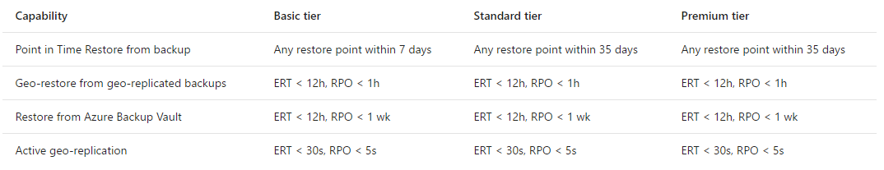
SQL Database features for Business Continuity
Recovery time objective (RTO) – maximum acceptable time before the application fully recovers after the disruption.
SQL Database
Point in time restore
Geo-restore
Restore from Azure Backup Vault
Active geo replication
Recovery point objective (RPO) – maximum amount of recent data updates (time interval) the application can tolerate losing.
Estimated recovery time (ERT) – estimated time interval needed to return service.
Notes:
NOTE: the RTO,RPO, ERT are business constraints
Note in a vault you can store database copies up to 10 years

Slide 75
Configure Data Replication Patterns
Features Available
Blob storage: geo-redundant and read-access geo-redundant storage
SQL Database: geo-restore, geo-replicate
CosmosDB/DocumentDB: global replication
Custom Code
Can write WebJob to copy data to other regions or on-premise
Notes:
Configure Data Replication Patterns
Data Replication and Synchronization Guidance
https://msdn.microsoft.com/en-us/library/dn589787.aspx
Azure Storage replication
https://docs.microsoft.com/en-us/azure/storage/storage-redundancy

Slide 76
You have a Web App that uses SQL Database. You need to make sure your database will not be down any less than a one minute. Which option should you use?
Point in Time Restore
Active geo-replication
Azure Backup Vault
Site Recovery
StorSimple
Notes:
2

Slide 77
Many Azure services are highly available (HA) by design – such as SQL Database, App Service, Azure Storage and CosmosDB. Others require you to use specific pricing tiers in order to get HA – such as Virtual Machines, Redis Cache and Search. Before taking the exam, you should look through the Service Level Agreements and learn what it takes to get HA for each product that is on the exam.
https://azure.microsoft.com/en-us/support/legal/sla/

Slide 78
App Service Backup
Configure a storage account and container to store backup
Can store backup in another region
Configure schedule for backup to occur
Can optionally backup database also (as a bacpac file)
Exclude files with a _backup.filter file listing paths to exclude
Limit of 10GB of content for a backup (site files + bacpac)
Stores backup as .zip
Notes:
Back up and Restore Data
** For a database to appear in this list, its connection string must exist in the Connection strings section of the Application settings blade for your app.
Back up your app in Azure
https://docs.microsoft.com/en-us/azure/app-service-web/web-sites-backup
Restore an app in Azure
https://docs.microsoft.com/en-us/azure/app-service-web/web-sites-restore

Slide 79
App Service Restore
Restore options:
Replace existing app (backup was taken from)
Replace another app or create another app based on backup
Notes:
Back up and Restore Data
Restore an app in Azure
https://docs.microsoft.com/en-us/azure/app-service-web/web-sites-restore

Slide 80
Design for Disaster Recovery
Backup/Restore - is about data or workloads and getting them back to a known state and running.
Disaster Recovery - is about getting your systems up and running in another location.
Recovery time objective (RTO) – maximum acceptable time before the application fully recovers after the disruption.
Recovery point objective (RPO) – maximum amount of recent data updates (time interval) the application can tolerate losing.

Slide 81
Design for Disaster Recovery
How do you bring up a new site in a new location, if not using Traffic Manager?
1. Database Layer
Initiate unplanned failovers to bring secondary site up as primary
or perform geo-restore from replicated backup
2. Storage Layer
If only have read only access, need process to copy in order to read/write
3. Web Layer
Restore from backup (stored in storage account for failover site)
or Redeploy from RM templates and code from Releases repository
4. Fix up connection strings
Notes:
3
Design for Disaster Recovery
Availability checklist
https://docs.microsoft.com/en-us/azure/architecture/checklist/availability
Best Practices: Windows Azure Websites (WAWS)
https://azure.microsoft.com/en-us/blog/best-practices-windows-azure-websites-waws/
Disaster recovery (DR) involves a set of policies and procedures to enable the recovery or continuation of vital technology infrastructure and systems following a natural or human-induced disaster.

Slide 82
You are evaluating your Web Apps for disaster recovery. What is the first thing you should look for?
Verify Backups are configured
Verify the SSL bindings
Check if Traffic Manager is setup
Confirm you are using Redis Cache
Notes:
1

Slide 83
Take a look at the Azure PowerShell cmdlets and the CLI documentation. The exam will have questions that use either PowerShell or CLI commands.
Just because this is a design level exam, does not mean there won’t be any code level questions.

Slide 84
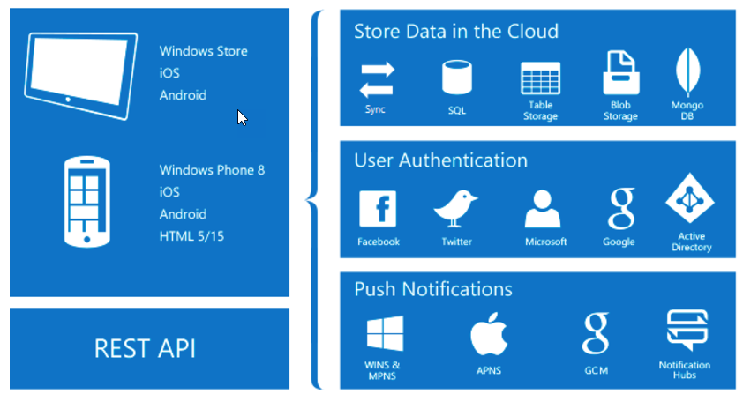
Design App Service Mobile Apps
Native and Cross Platform
Connect your enterprise
Build offline-ready apps
Scalable Push Notifications
Client SDKs:
iOS
Android
Windows
Xamarin
Cordova
Notes:
What is Mobile Apps?
https://docs.microsoft.com/en-us/azure/app-service-mobile/app-service-mobile-value-prop

Slide 85








Offline Sync Capabilities
Mobile Client App – use platform specific SDKs and local data stores
SQL Lite or Core Data on iOS
Server endpoint – use SDK TableController base class for table syncing
Mobile Client App using SDKs
Mobile App/API App or Web App using SDKs
SQL Lite/Core Data
IMobileServiceSyncTable
TableController<T>
Notes:
Integrate Offline Sync Capabilities Into an Application
Offline Data Sync in Azure Mobile Apps
https://docs.microsoft.com/en-us/azure/app-service-mobile/app-service-mobile-offline-data-sync

Slide 86
Users of your mobile application need access to an on-premise database. Which of the following are valid steps for exposing that data?
Download and install the Hybrid Connection Manager
Add new hybrid connection
Configure Hybrid Connection Manager
Change connection string in web.config to point at new endpoint
Create Service Bus Relay
Notes:
2, 5
https://docs.microsoft.com/en-us/azure/app-service/app-service-hybrid-connections

Slide 87
Extend Mobile Apps using Custom Code
Mobile Client SDKs available for:
Android
Apache Cordova
iOS
Windows
Xamarin.Android
Xamarin.Forms
Xamarin.iOS
Notes:
Extend Mobile Apps using Custom Code
Android
https://docs.microsoft.com/en-us/azure/app-service-mobile/app-service-mobile-android-how-to-use-client-library
Cordova
https://docs.microsoft.com/en-us/azure/app-service-mobile/app-service-mobile-cordova-how-to-use-client-library
iOS
https://docs.microsoft.com/en-us/azure/app-service-mobile/app-service-mobile-ios-how-to-use-client-library

Slide 88
Implement Mobile Apps Using Microsoft .NET or node.js
Mobile App server SDKs available for:
.NET
Node.js (has Easy Tables and Easy APIs available in portal)
SDKs provide:
Table operations for data access
Custom API operations
Push Notifications
Integration with Authentication
Notes:
Implement Mobile Apps Using Microsoft .NET or node.js
.NET
https://docs.microsoft.com/en-us/azure/app-service-mobile/app-service-mobile-dotnet-backend-how-to-use-server-sdk
Node.js
https://docs.microsoft.com/en-us/azure/app-service-mobile/app-service-mobile-node-backend-how-to-use-server-sdk

Slide 89
You have an existing Web App and want to add a Mobile App to the site. What do you need to do?
Create a new Web App
Create an Azure AD Application Proxy
Merge your Web App and Mobile App server code base
Create a Service Bus Namespace

Slide 90
Secure Mobile Apps Using Azure AD
Mobile Client Apps use platform specific Azure Mobile Client SDKs
Server is same as App Service Authentication/Authorization
On Premises AD
1. Connect and Sync with Azure AD
2. Authenticate through Azure AD
Azure AD B2B or B2C
Facebook
Google
Twitter
Microsoft Account
Notes:
Secure Mobile Apps Using Azure AD
How to configure your App Service application to use Azure Active Directory login
https://docs.microsoft.com/en-us/azure/app-service-mobile/app-service-mobile-how-to-configure-active-directory-authentication
Authentication and Authorization in Azure Mobile Apps
https://docs.microsoft.com/en-us/azure/app-service-mobile/app-service-mobile-auth

Slide 91
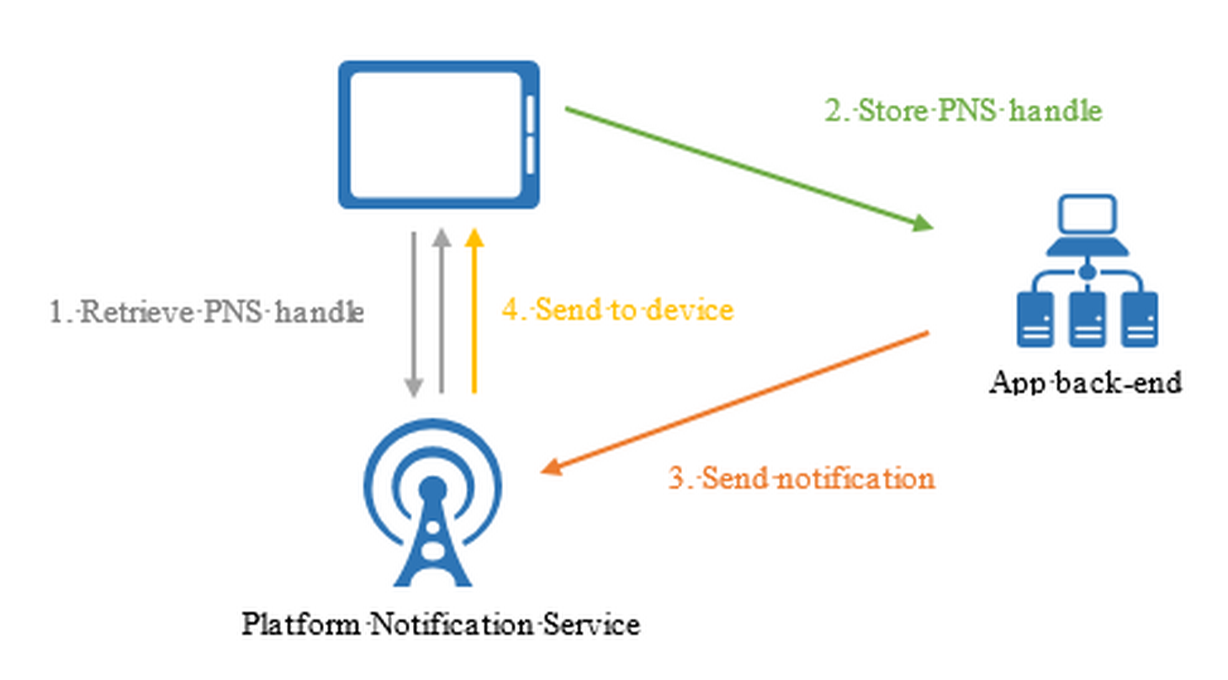
Implement Push Notification Services in Mobile Apps
Abstracts the choreography to support push notification to mobile clients
Apple Push Notifications (APNS)
Google Cloud Messaging (GCM)
Windows (WNS)
Windows Phone (MPNS)
Amazon (ADM)
Notes:
Implement Push Notification Services in Mobile Apps
Add push notifications to your Windows app
https://docs.microsoft.com/en-us/azure/app-service-mobile/app-service-mobile-windows-store-dotnet-get-started-push

Slide 92
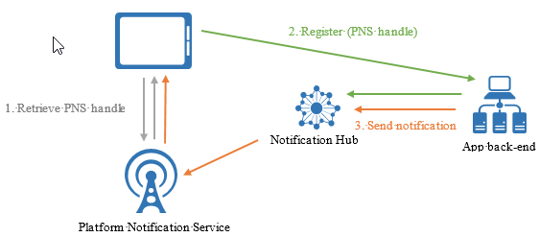
Send Push Notifications
Push on the App Service menu - Uses Notification Hubs
Broadcast to one or multiple platforms
Push to device or user
Push to segment with dynamic tags
Localized push
Silent push
Scheduled push
Direct push
Personalized push
Notes:
Send Push Notifications to All Subscribers
Send Push Notifications to Specific Subscribers
Send Push Notifications to a Segment of Subscribers
Azure Notification Hubs
https://docs.microsoft.com/en-us/azure/notification-hubs/notification-hubs-push-notification-overview

Slide 93
Mobile Apps are part of App Service, so the Authentication, Networking, Scaling, WebJobs, etc. are also available for Mobile Apps too.

Slide 94
Mobile Apps are mobile client apps and sever backend apps. Be prepared to answer questions on Node.js as well as .NET.
If you have never created a Node.js application, make sure you take the time and do the Mobile Apps tutorials that use Node.js for the backend.

Slide 95
Since there are multiple languages for the Mobile App SDKs, be familiar with the common objects and what they are used for. Both on the client sdk and server sdk.

Slide 96
Which of the following technologies can you build a Web API with?
Express
Restify
ASP.NET Web API
ADAL
Angular
Notes:
3

Slide 97
You have an on-premise ASP.NET MVC website that uses windows authentication. Which of the following items are steps you need to take in moving it to Azure?
Create an Azure AD
Create a SQL Database
Create and deploy as a Web App
Create a Redis Cache
Add application to Azure AD
Use the Authorize attribute
Connect and Sync local AD with Azure AD
Notes:
1,3,5,7
<system.web> <authentication mode="Windows" /> </system.web>

Slide 98
You are concerned about the performance of a new Web App and want to make sure it scales when it starts to get heavy use. Which choice is the best for you to do?
Deploy another instance from Github
Change the Pricing tier to a larger machine size?
Configure auto scale to increase instance count when CPU hits 80%
Stop all WebJobs currently running on the WebApp
Notes:
3

Slide 99
You have a website that uses a lot of session state. You need to move the site to a web app in Azure. What two choices should you do?
Create a Virtual Machine
Create a Redis Cache
Download and configure the ASP.NET Session State Provider in your web.config
Deploy your web application to the virtual machine
Notes:
2,3

Slide 100
You are having problems with stability of your latest website release. What can you do to minimize downtime?
Create multiple instances of your Web App
Change the App Service Plan to Premium
Setup VNET Integration
Create another deployment slot
Notes:
1

Slide 101
You are launching a beta site and have little budget to spend. You need to be ready in case the site or db goes down and are ok with some downtime. What is the best thing to do?
Deploy another Web App but don’t give anyone the URL
Setup Traffic Manager
Setup Backup for the Web App using a storage account in another region
Create a WebJob that backs up the database
Notes:
3

Slide 102
You have a mobile app and need to allow your users to enter data while they are not online or connected to a network. What do you need to do?
Download your Windows Store certification
Change the native client app code
Expose a new endpoint on your server for data synchronization
Create a new Azure AD
Notes:
2
With offline sync, you read to and write from a sync table (using the IMobileServiceSyncTable interface), which is part of a SQLite database on your device.

Slide 103
You have a Mobile App. Your managers want an alert on their mobile app about sales numbers at the end of day. How can you do that?
Set up an Alert for the App Service
Use Azure Scheduler to send the alert
Use a webhook
Use a Push Notification
Notes:
4

Slide 104
Your Mobile App needs to authenticate users from an on-premise Active Directory. What do you need to do?
Connect and Sync AD to Azure AD
Configure Mobile App to use Azure AD
Configure Vnet integration
Add a SSL binding
Notes:
1,2

Slide 105
Design Azure Web and Mobile Apps
Eric Franz | Solution Lead
www.concurrency.com

